Slide 1
Overwatch 2 Data Analysis
Bryan Oyuela

Slide 2
Table of Contents
01
04
Introduction to Overwatch
Hidden Statistical Analysis
02
05
Understanding Overwatch Statistics
Health in Overwatch
03
06
Scoreboard Statistics Analysis
Discussions Around State of Overwatch
Notes:
https://www.deviantart.com/miraculousthomasfan/art/Overwatch-2-Baptiste-and-Tracer-Screenshot-968553319

Slide 3
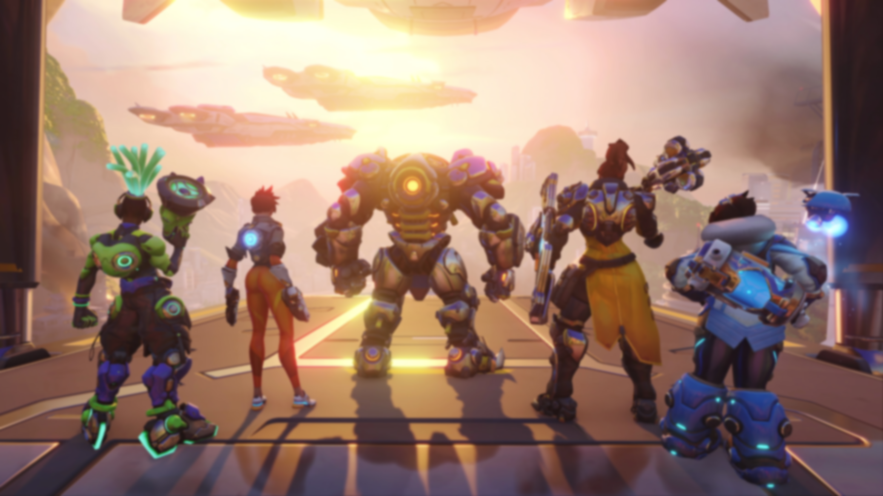
01
Introduction to Overwatch

Slide 4
What is Overwatch?
Revolutionary Genre
Competitive Format
Massive Roster
Overwatch is a hero
based first-person
shooter game available
on consoles and PCs
Players participate in a
5-on-5 objective-
based match
Currently has 39
unique heroes, 26
unique maps, and 5
competitive modes

Slide 5
Why Overwatch?
Early Pioneer
Immense Experience
Rigorous Analysis
I’ve played Overwatch since it launched in
2016
After 700+ hours of gameplay experience, I’ve become passionate for the game, its heroes, and its lore
300 data points & over 6 hours of gamplay

Slide 6

“Never accept the world as it appears to be. always dare to see it for what it could be.” -Jeff Kaplan, Director of Overwatch (2016-2021)
—

Slide 7

About the project
A passion project that will allow me to exercise my Excel, SQL, and Tableau skills
An analysis of how basic, advanced, and hidden statistics affect outcomes of games

Slide 8
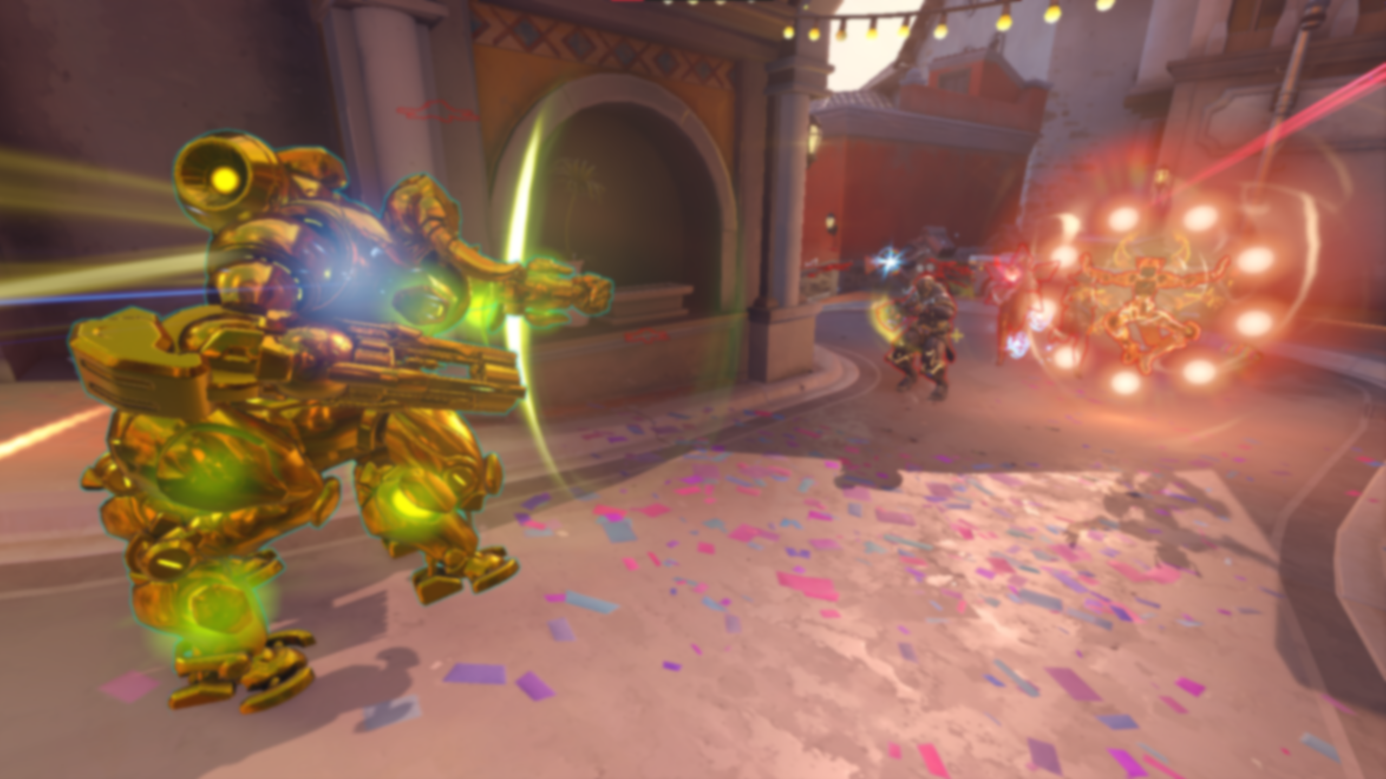
02
Understanding Overwatch Statistics
A crash course on basic Overwatch statistics

Slide 9
Scoreboard Statistics
Impact Stats
Tally Stats
Participation that turns the tide of battle
Eliminations: Damage participation that led to the death of an opponent
Assists: Utility participation that led to the death of an opponent
Death: Player’s health drops to zero and is unable to play for 10 seconds
Performance indicators that can diagnose problems
Damage: Damage done to an enemy
Healing: Healing dealt to wounded allies
Mitigation: Damage absorbed and mitigated (not damage taken)

Slide 10
Things to Consider
Impact Stats
Some characters and roles are more capable of producing each stat
For example, supports are more likely to generate assists than other roles
For example, Mercy produces very few eliminations while Illari can produce lots of eliminations
These numbers/stats are a direct result of performance and are strong predictors of success in matches
Tally Stats
High tally stats are not a strong indication of impact
For example, Damage players may have high damage outputs. However, high damage and low eliminations are an indication that the player is struggling to finish opponents off.
For example, Reinhardt has a shield with massive amounts of health (results in high mitigation stats). However, characters like Junkerqueen have no shields (and thus, low mitigation), but can carry a game with high eliminations.

Slide 11

03
Scoreboard Statistics Analysis
The impact of Overwatch 2’s easily accessible statistics

Slide 12
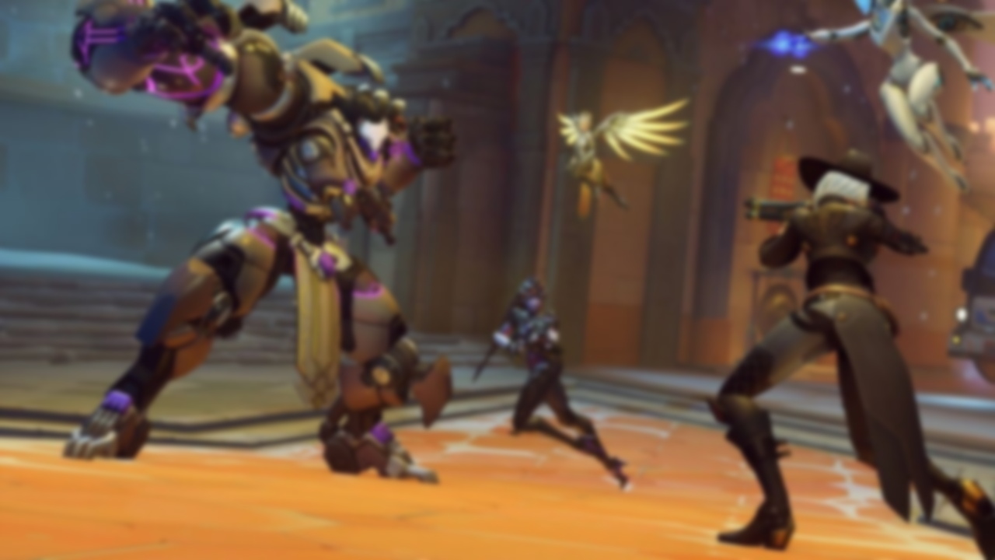
Top 10’s
The impact of damage mitigation, eliminations, healing
Notes:
https://thenerdstash.com/overwatch-2-season-3-release-date-map-rewards-more/

Slide 13
Mitigation Insights
Characters | Mitigation | Affiliation | Result
Reinhardt | 33,234 | Opponent | Loss
Sigma | 21,744 | Friendly | Win
Reinhardt | 19,421 | Friendly | Win
Orisa, Winston | 18,414 | Friendly | Win
Sigma, Reinhardt | 14,156 | Friendly | Win
Winston, D.Va, Ramattra | 12,880 | Opponent | Win
Ramattra | 10,767 | Opponent | Loss
Reinhardt, Orisa | 10,614 | Opponent | Win
Reinhardt, Sigma | 10,446 | Opponent | Loss
Junkerqueen, Winston | 10,361 | Friendly | Loss
Among the top 5, the highest mitigation totals corresponded to favorable match outcomes.
However, when examining 6th through 10th, contributions were not always enough.
Reinhardt accounts for half of the entries in the top 10. This is due to high barrier HP.

Slide 14
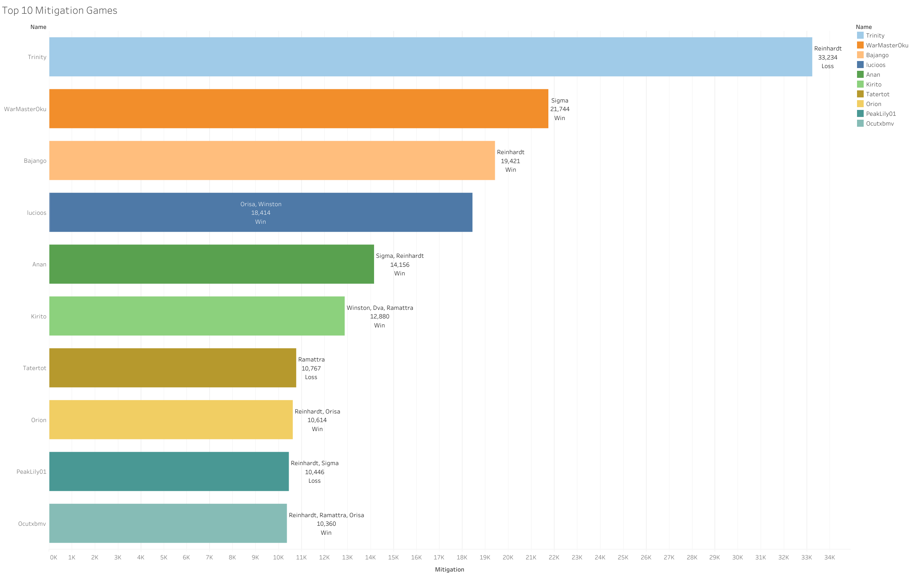

Slide 15
Elimination Insights
Characters | Elims | Affiliation | Result
Doomfist, D.Va | 35 | Opponent | Loss
Cassidy, Soldier: 76 | 35 | Opponent | Loss
Moira | 34 | Opponent | Loss
Junkrat, Hanzo | 33 | Friendly | Win
Bastion | 33 | Opponent | Loss
Orisa, Winston | 32 | Friendly | Win
Soldier: 76, Symmetra, Pharah | 32 | Friendly | Win
Bastion, Symmetra | 31 | Friendly | Win
Genji | 30 | Opponent | Loss
Doomfist | 30 | Opponent | Loss
In all 10 entries, the most dominant players usually led their teams into positive outcomes.
9 of 10 entries were from players in the Tank and Damage role.
Doomfist shows up twice despite being one of the weakest characters in the game.

Slide 16
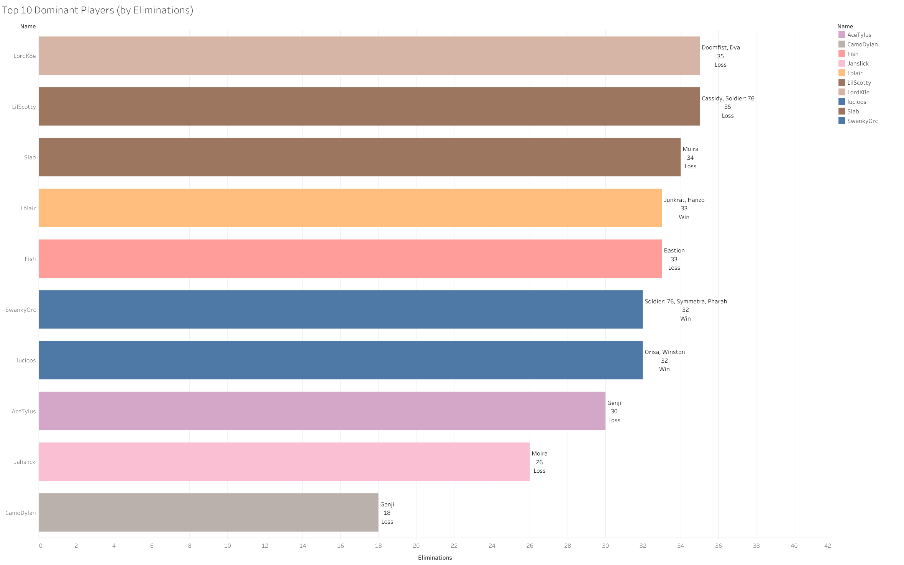

Slide 17
Healing Insights
Characters | Healing | Affiliation | Result
Kiriko | 14,835 | Friendly | Loss
Kiriko | 13,704 | Opponent | Win
Ana, Illari | 13,002 | Friendly | Win
Illari | 12,845 | Friendly | Win
Lifeweaver | 12,811 | Opponent | Loss
Lifeweaver | 12,737 | Opponent | Loss
Baptiste | 12,287 | Opponent | Loss
Lifeweaver | 11,819 | Friendly | Win
Kiriko | 11,780 | Opponent | Loss
Baptiste, Ana | 11,057 | Friendly | Loss
High healing numbers are the least predictive of match outcomes
All entries come from main healers
Surprisingly, there is no Moira (well known for high healing) entry in the top ten

Slide 18
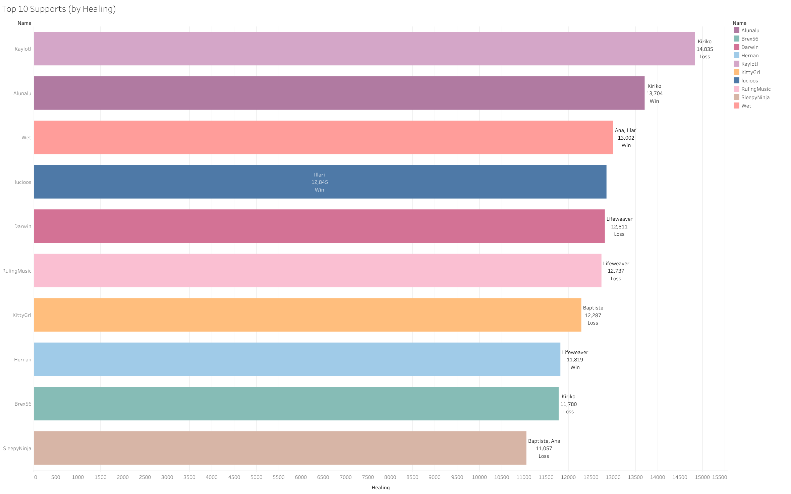

Slide 19
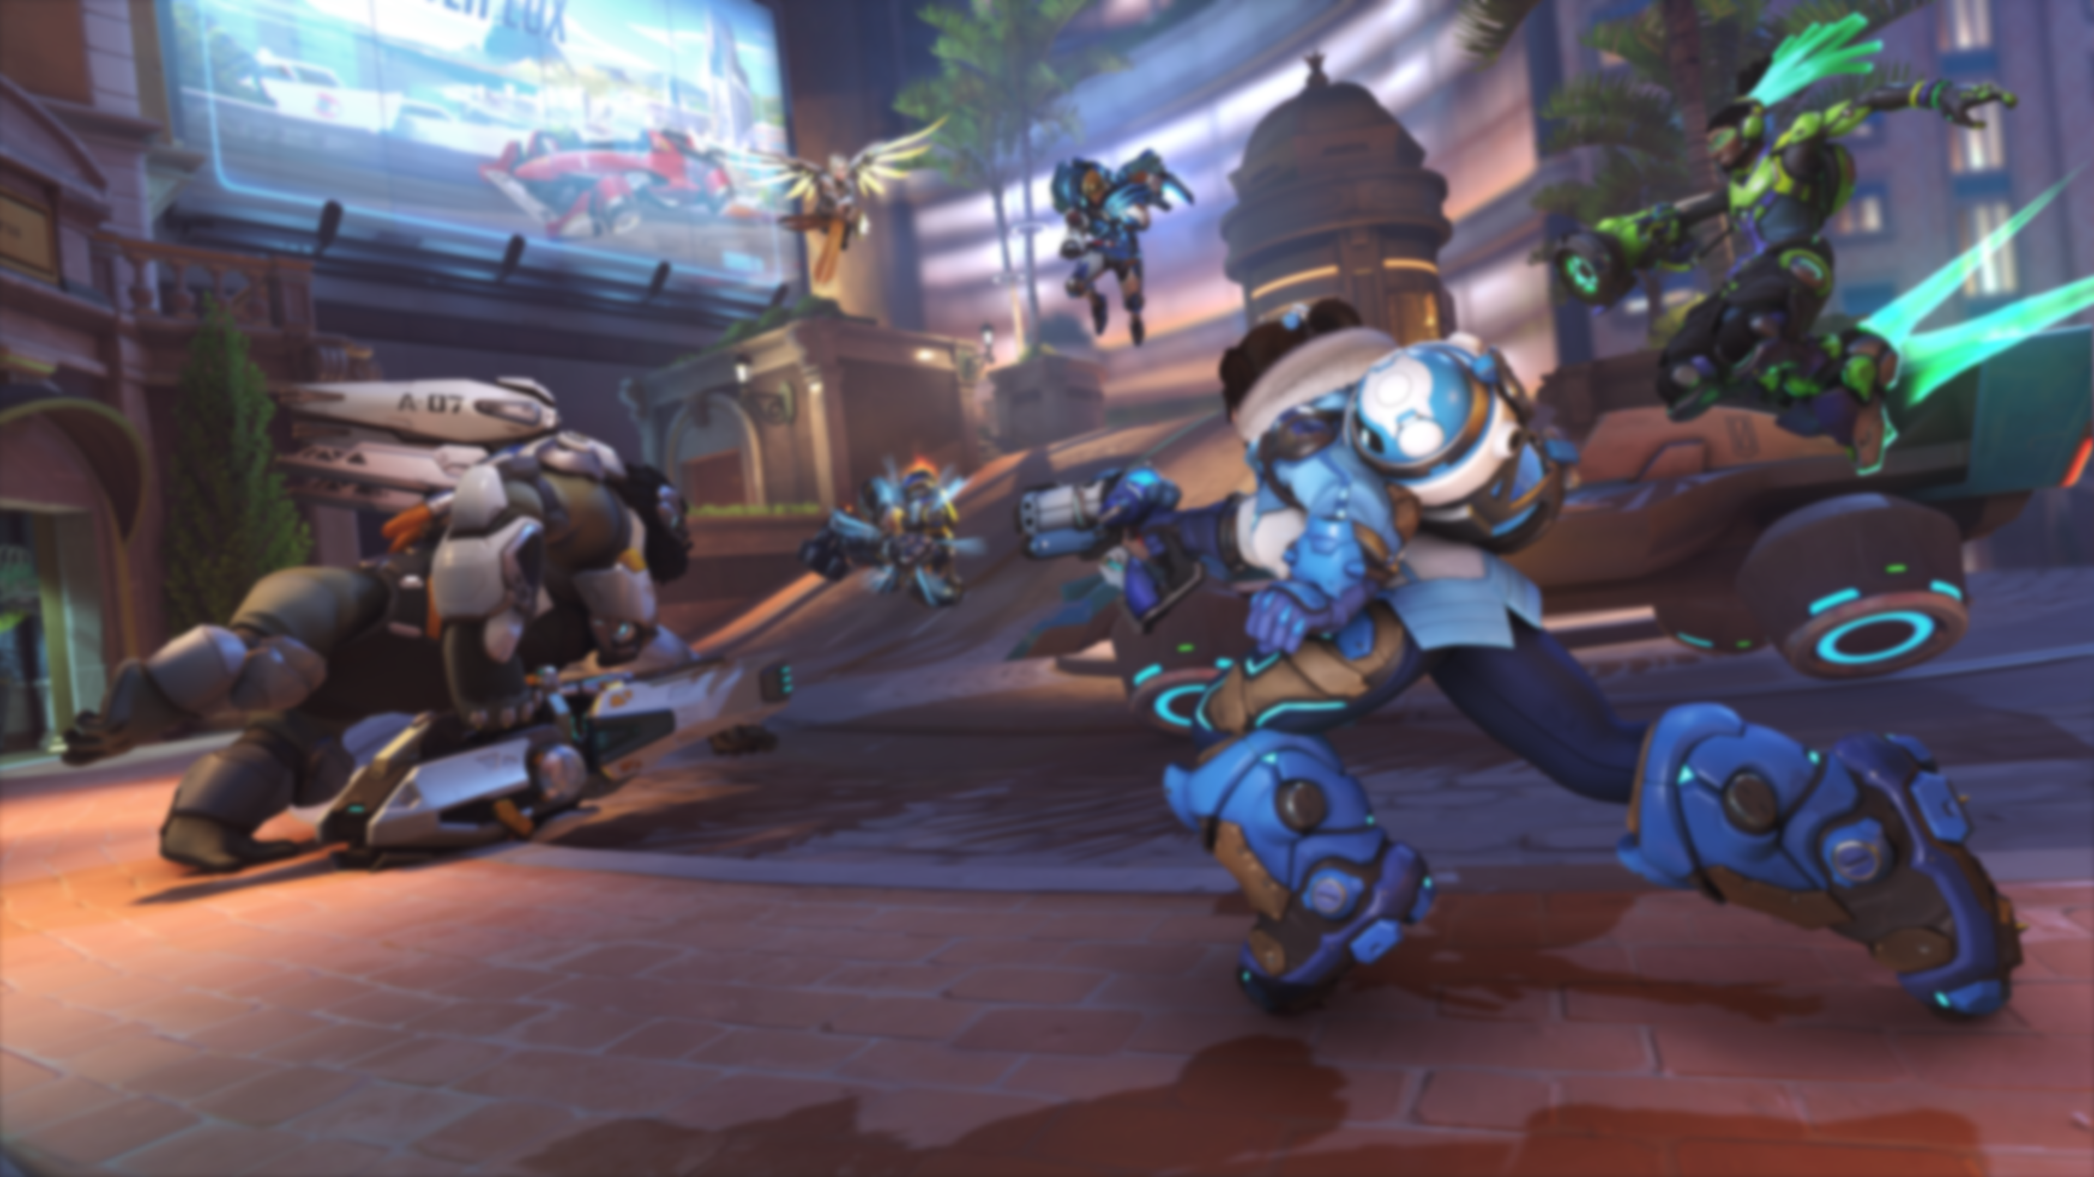
04
Hidden Statistical Analysis
Ultimates & Map/Mode Win Percentages
Notes:
https://nordic.ign.com/overwatch-2/55167/gallery/overwatch-2-pvp-beta-screenshots?p=1

Slide 20

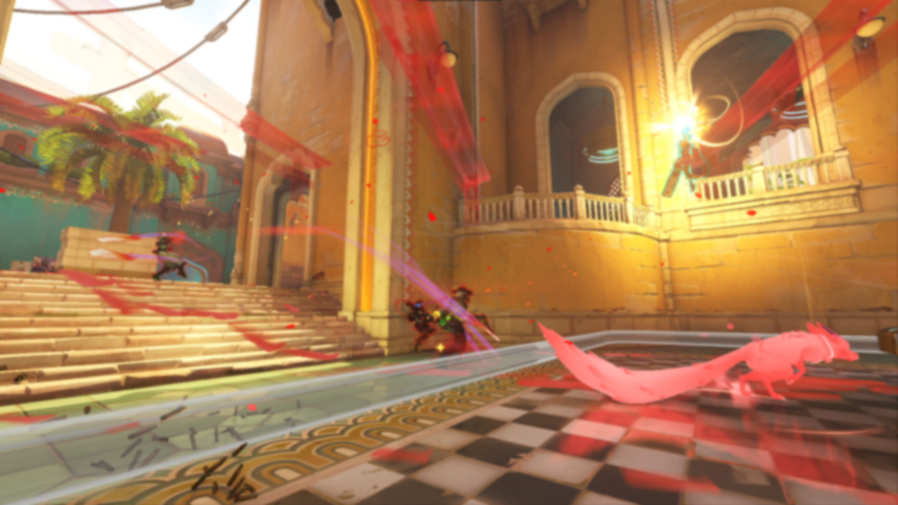
Ultimates and Their Impact

Slide 21
Ultimates: A Valuable Resource
Turning the Tide
Charge Over Time
Unique Utility
Powerful tools that can save allies or annihilate the enemy team
Passively charges over time and can be sped up by in-game participation
Each hero has its own ultimate and utility

Slide 22
Ultimates Used by Affiliation
Query reveals that my opponents used more ultimates than my team did
Query reveals a 32-use difference between allies and opponents
Friendly Ultimates | Opponent Ultimates | Ultimate Difference
340 | 372 | -32

Slide 23
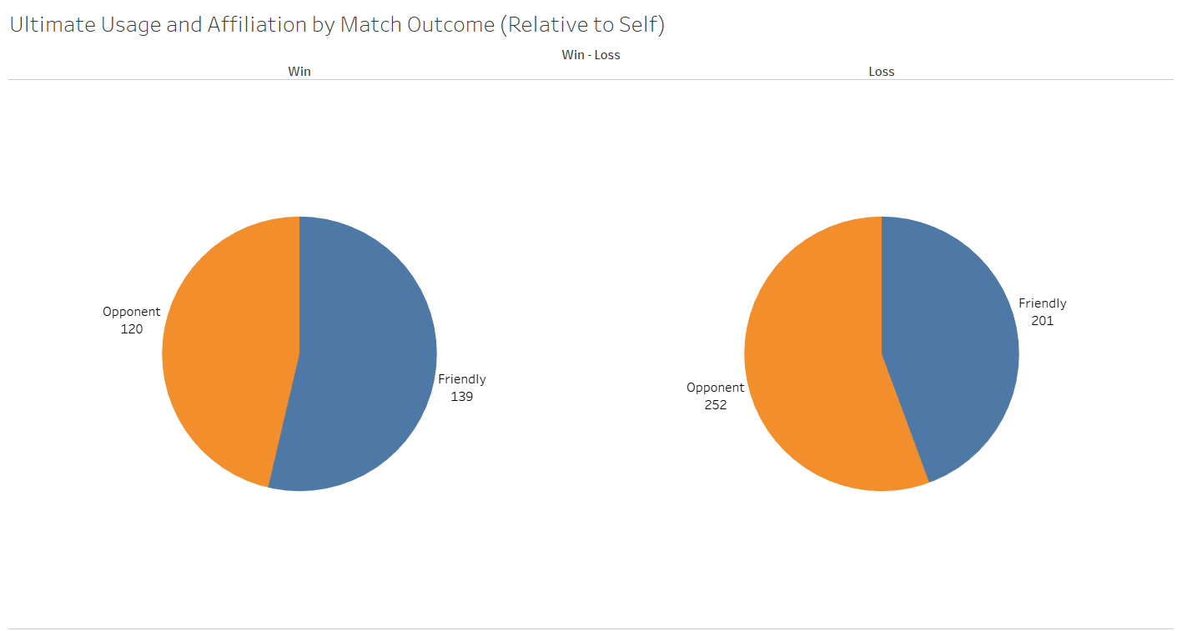
Usage and Affiliation by Outcome
Visual breakdown of ultimate usage by each time that led to two different outcomes (Win/Loss)
Teams that used ultimates more usually win the game

Slide 24
Worth Noting…
Winners Build More Ultimates
Positive Impacts Leads to More Ultimates
Holding Ultimates?
Teams that won multiple fights in a row have significantly higher ultimate usage
Getting eliminations and healing allies leads to building ultimates faster
Holding ultimates can be helpful if your team has invested resources

Slide 25
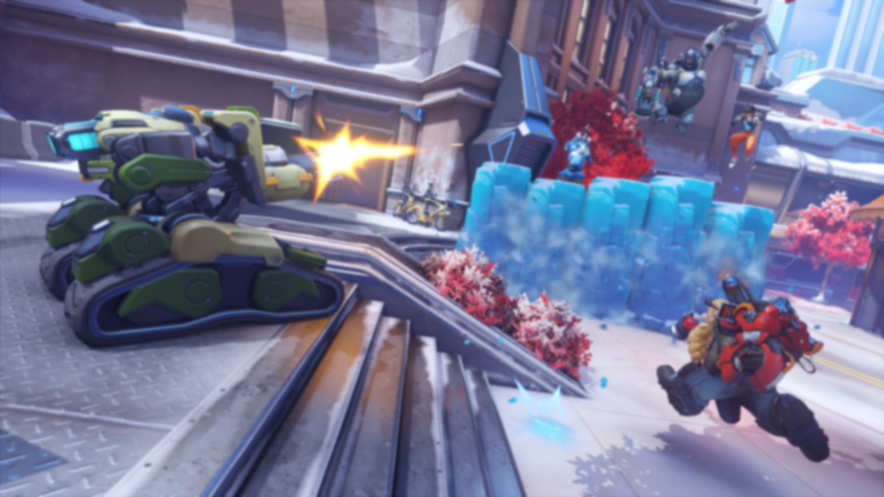
Game Modes and Fronts
Notes:
https://za.ign.com/overwatch-2/162833/gallery/overwatch-2-pvp-beta-screenshots?p=1

Slide 26
The 5 Game Modes
Escort
Push
Flashpoint
Control
Hybrid
Escorting a payload
through objectives
Escorting a robot in
a tug-of-war style game
Capturing points of
interest throughout one
massive map
Capture and protect
a point throughout
multiple sections of
a map
Capture a point and
escort a payload
through objectives

Slide 27
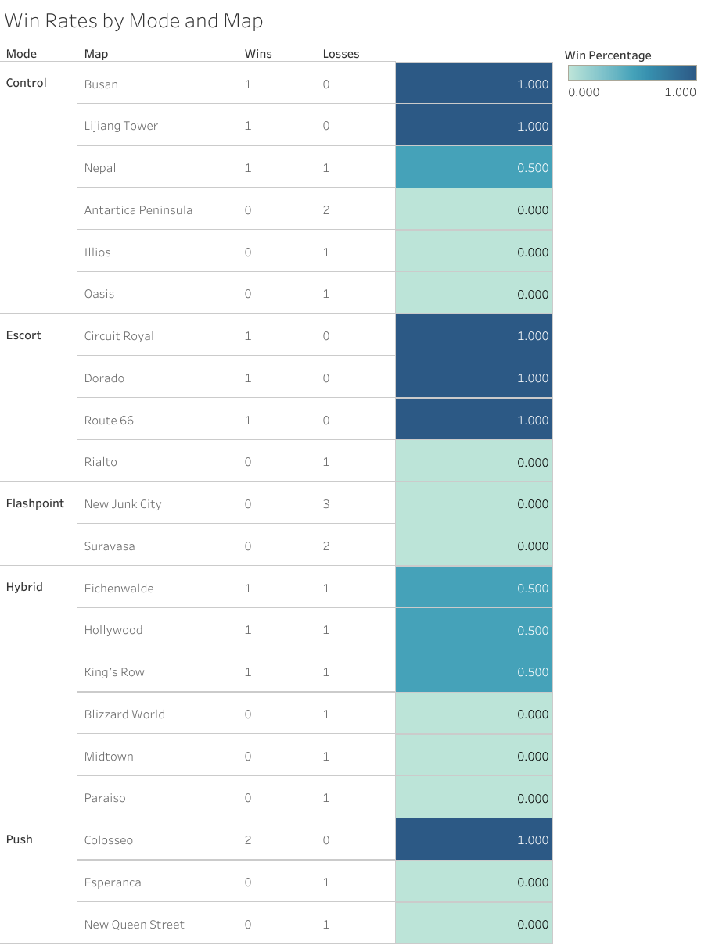
Win Rates by Mode and Map
30 games was too small of a sample size for meaningful statistics on maps
Maybe narrowing to modes will reveal something more interesting

Slide 28
Win Rates by Mode
Mode | Wins | Loss | Win %
Escort | 3 | 1 | 75%
Push | 2 | 2 | 50%
Control | 3 | 5 | 37.5%
Hybrid | 3 | 6 | 33.33%
Flashpoint | 0 | 5 | 0%
Not enough data
Still better than having only 1 data point/map
Flashpoint is clearly a weak point (did notice many backfill games in FP)

Slide 29
The 3 Fronts
Attack
Mutual
Defense
Focused entirely on
capturing objectives
and playing game to
completion
Applies to see-
saw/tug-of-war game
modes for purposes of
project
Focused on defending
objectives and
obstructing
progress until time
runs out

Slide 30
Win Rates by Front
Front | Wins | Loss | Win %
Attack | 4 | 3 | 57.14%
Defense | 2 | 4 | 33.33%
Mutual | 5 | 12 | 29.41%
Had the most success on attack
Mutual games (including Flashpoint) went bad for me
These statistics wouldn’t be helpful in analyzing competitive games

Slide 31
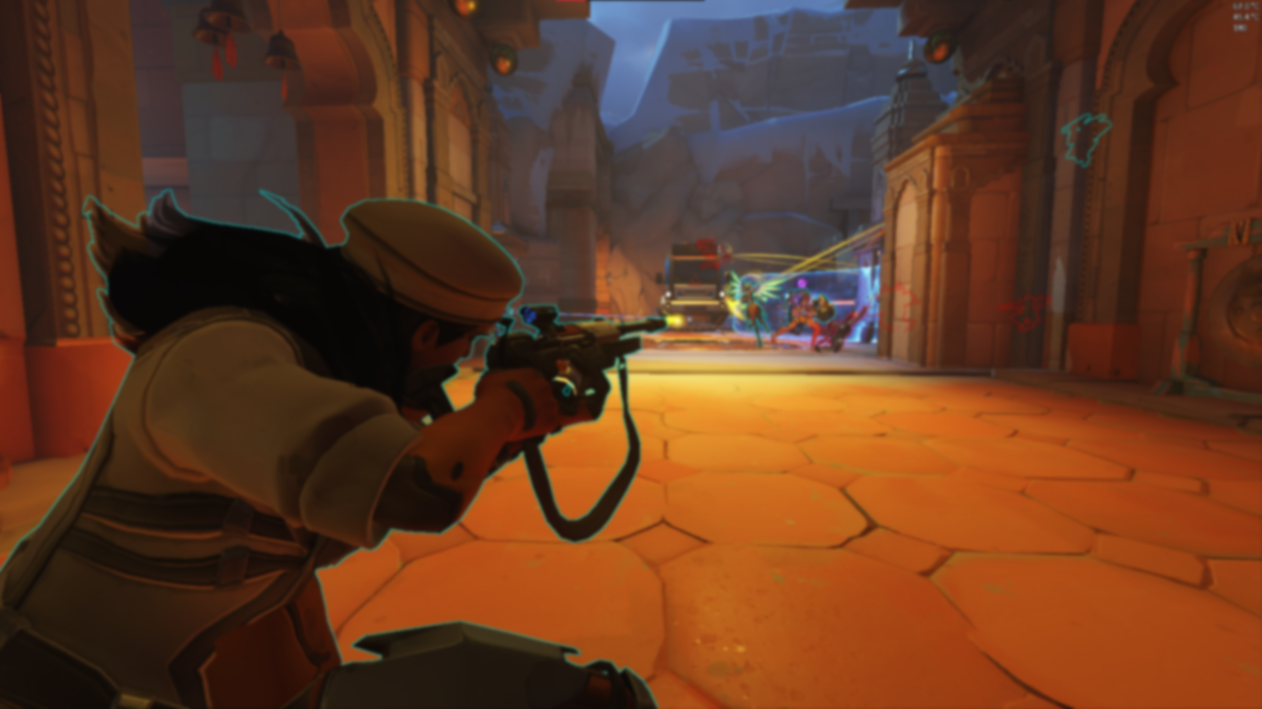
05
Health in Overwatch
How health, damage, and healing interact in Overwatch

Slide 32
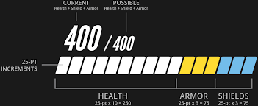
Health Types in Overwatch 2
Raw Health
Armor
Regular health represented by white bars
Health bars that mitigated 30% of incoming damage
Shields
Overhealth
Regenerative health represented by blue bars
Health provided from outside sources like ultimates represented by green bars

Slide 33
Types of Calculated Health
Total Health
Effective Health
The number that displays on your health bar and the sum of raw health, armor, and shields
The actual amount of damage you can take when considering the mitigating effects of armor

Slide 34
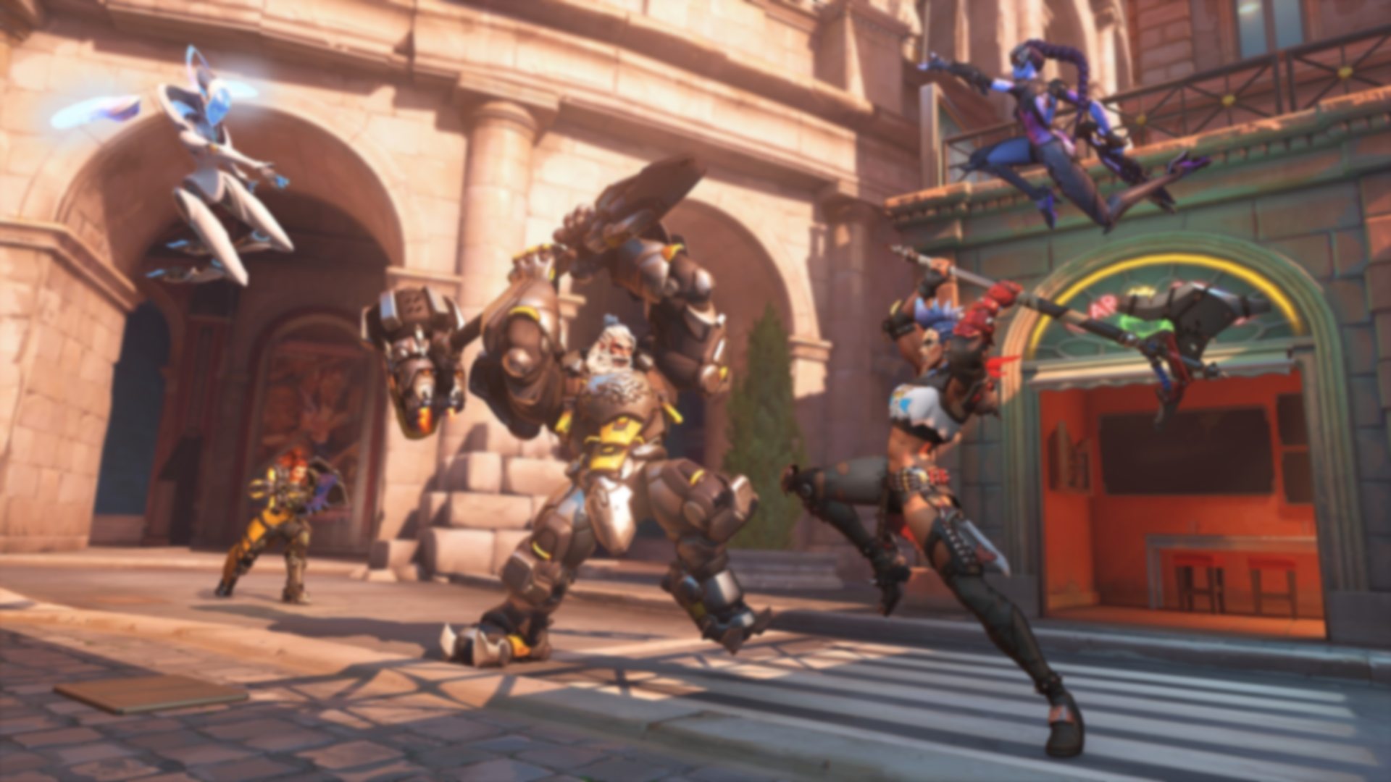
E.Health vs. T.Health

Slide 35
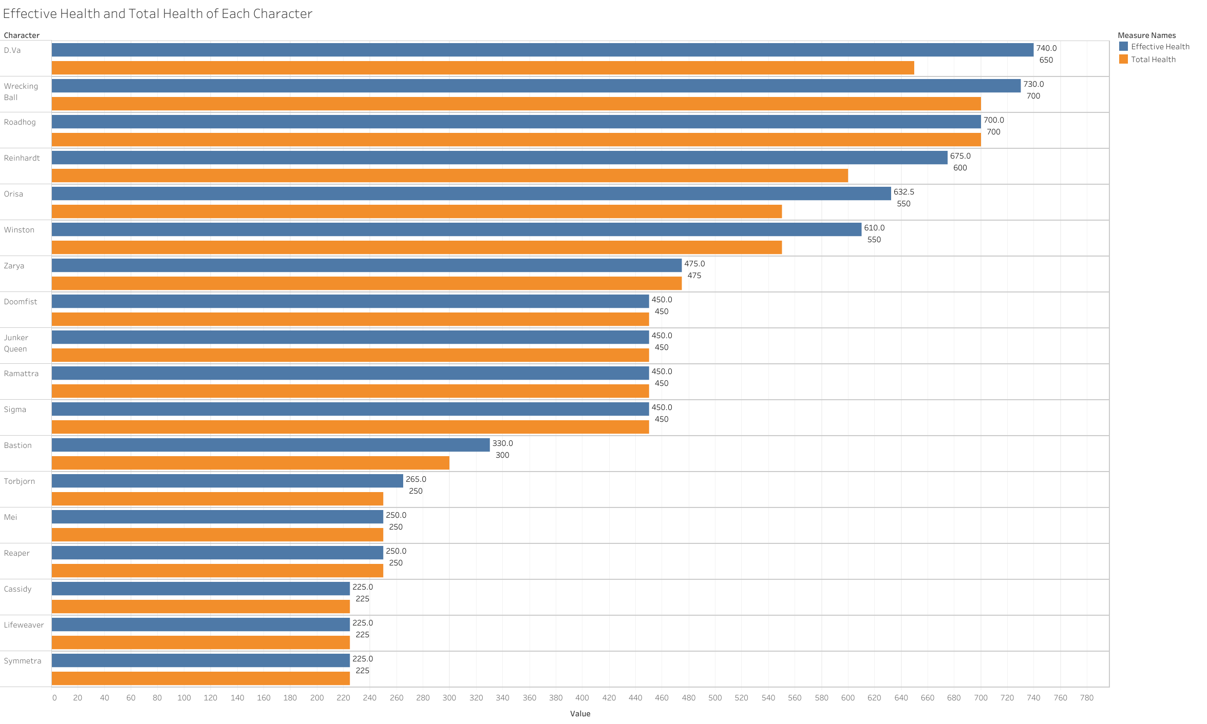

Slide 36
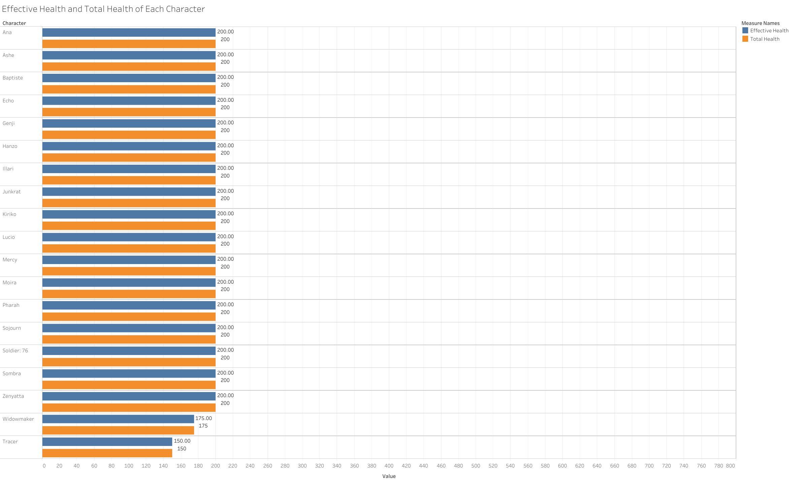

Slide 37
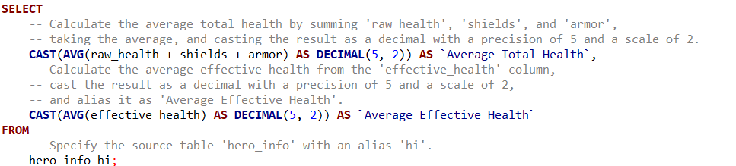
Average total health and average effective health of all 39 heroes
Average Total Health | Average Effective Health
307.24 | 317.70
The calculation of average damage to eliminate all heroes when Armor is and isn’t accounted for
10 damage discrepancy

Slide 38
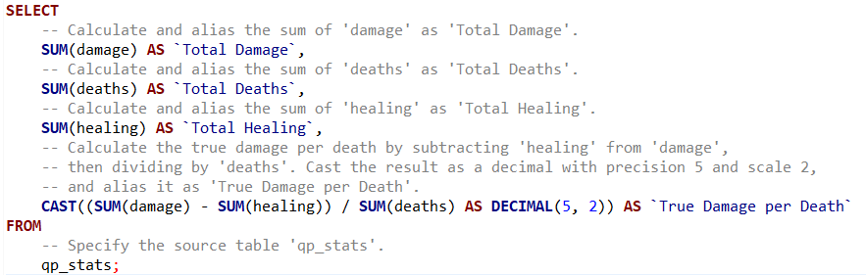
True Damage per Death
Total Damage | Total Deaths | Total Healing | True Damage per Death
2,863,482 | 3,176 | 1,663,694 | 377.77
True Damage: Damage dealt – Healing Provided
True Damage per Death: True damage necessary, on average, to account for all player deaths in my games
60 damage discrepancy from previous calculation due to character variations

Slide 39
Difference in Damage vs. True Damage
Damage per Death | True Damage per Death | Difference in DTD
901.60 | 377.77 | 523.83
Current complaints within community: this discrepancy is higher than usual
Healing accounted for a 524 extra health per death
Higher Damage per Death leads to slower gameplay
Would be interesting to compare these numbers to previous seasons

Slide 40
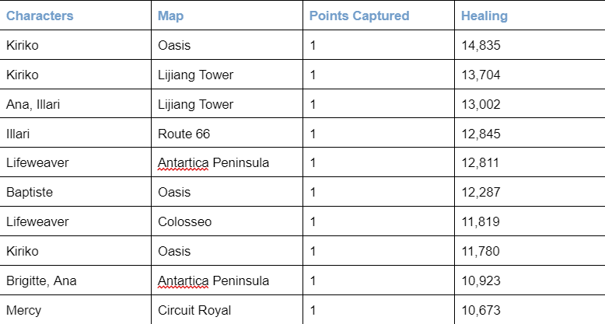
Total Healing When A Match is Played to Completion
Completion = All possible objectives were captured before game ended
Main healer characters (Kiriko, Lifeweaver, Baptiste, and Illari) are being played a lot and are outputting massive amounts of healing

Slide 41

06
Discussions Around State of Overwatch
Meta Picks and Powercreep

Slide 42
Defining Key Terms
M.E.T.A Compositions
Powercreep
M.E.T.A. (Most Effective Tactics Available): A term used to describe the optimal way of doing something withing a video game
In Season 6 of Overwatch 2, the “META” composition is a Bunker-style sustain composition
Powercreep: A balance phenomenon where, over time, new content makes older ones obsolete.
This creates an imbalance and loss of diversity in games
Typically leads to mega-buffs for old characters that can break a game’s balance

Slide 43
The Current Meta
Bunker, High-Sustain Composition
META defined by characters with deployables and high healing outputs
Longer team fights
Unpleasant play for teams that don’t want to play this composition
Began to play the characters I listed above and noticed that I was winning more consistently
Rock, Paper, Scissors
Counter-Swapping
Switching onto characters they don’t play but need to (a lot of the time)
Found myself in this situation multiple times during this experiment
Game encourages swapping off heroes (retain 25% of ultimate charge upon switch hero)

Slide 44
Powercreep
More invincibility
Since Overwatch 2’s release, they have added 3 new support heroes (Kiriko, Illari, and Lifeweaver)
Specifically, Kiriko and Lifeweaver have ways to negate negative status effects
They can also save teammates who have misplayed
Extremely frustrating to play against, but playing these characters is extremely satisfying
Even more healing
As we discussed earlier, healing outputs are extremely high
The 3 new support heroes are consistently among the highest healing leaderboards
Has enabled bunker-like playstyles

Slide 45
Thanks!
I hope that this slideshow was informative!
It’s extremely interesting to understand how data in Overwatch 2 can be used to draw conclusions
Please keep this slide for attribution

